Slide 1
FS Laser Operation-Draft 2
Weston Middle School

Slide 2
Log In to Computer
Turn on the PC power switch and screen power
Allow to boot up( 3 min)
Ctrl-Alt-Delete
Log in with Weston username and password

Slide 3
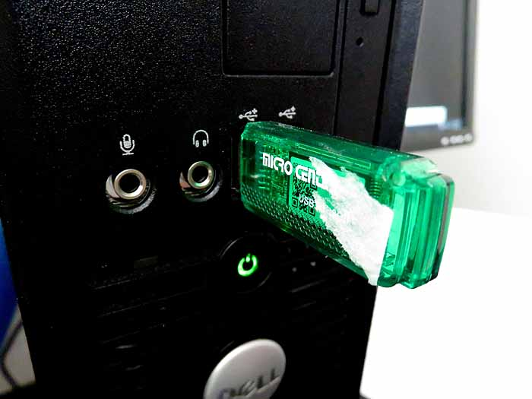
Upload files to Desktop
Plug in flash drive, drag SVG files onto desktop

Slide 4
Launch Programs
Programs- Retina Engrave
Programs- Corel Draw

Slide 5
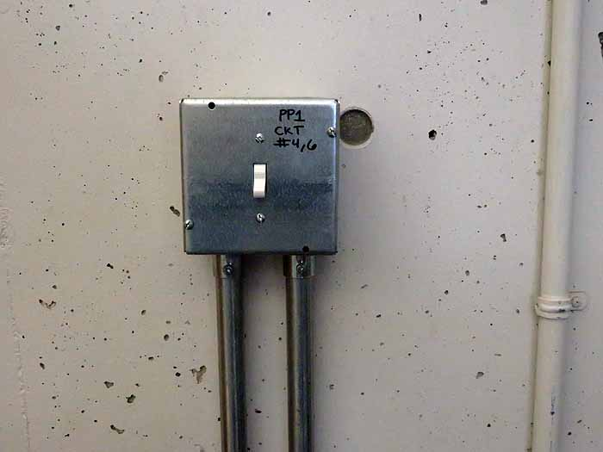
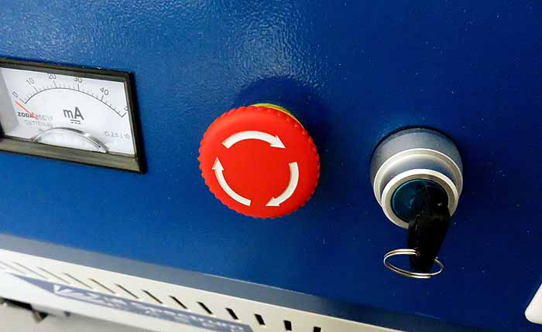
Turn on Laser System
Turn on wall power switch; chiller, compressor, and blower should start up
Chiller Temp should read 21-22 degrees C
Turn on Key Switch on Laser
Pull out Laser Power switch

Slide 6
Wait for Laser to Boot Up

Slide 7
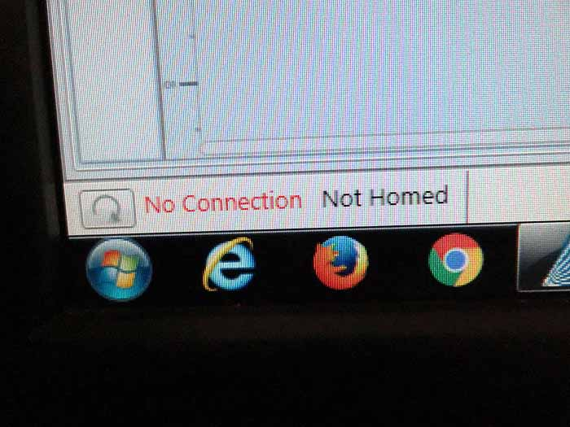
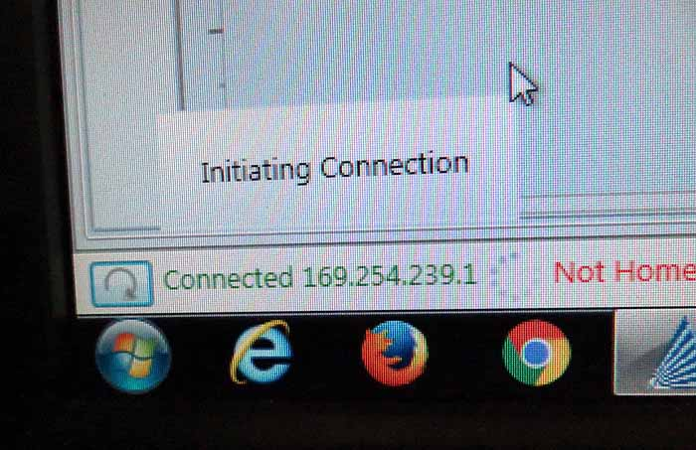
Once Laser has booted up….
Refresh connection in lower-left of Retina Engrave; wait for green “connected” message

Slide 8
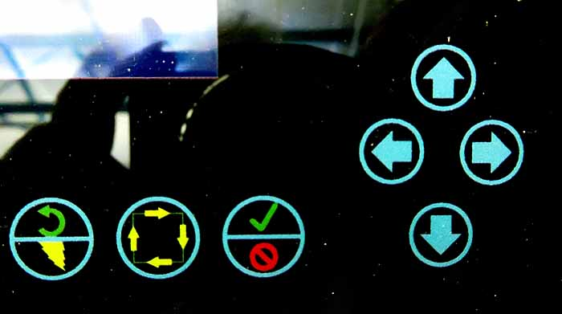
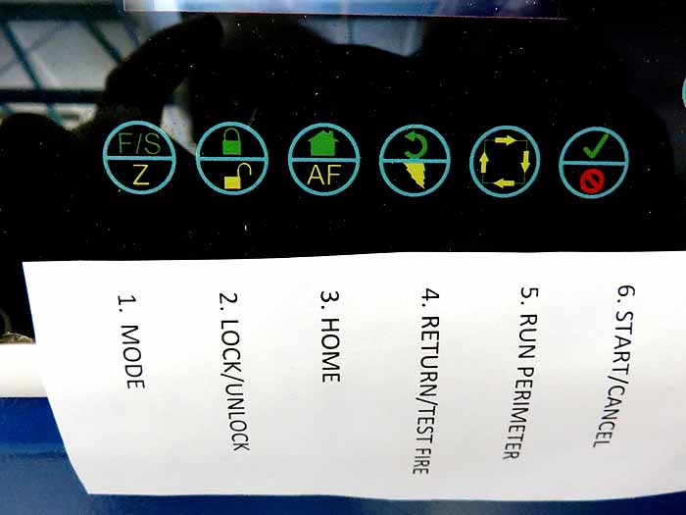
Adjust Z-Axis focus
Insert material onto honeycomb tray
Press Mode switch( left switch) until display says “Fast Z”
Using up+down arrow buttons, adjust height so auto-focus switch just touches stock

Slide 9
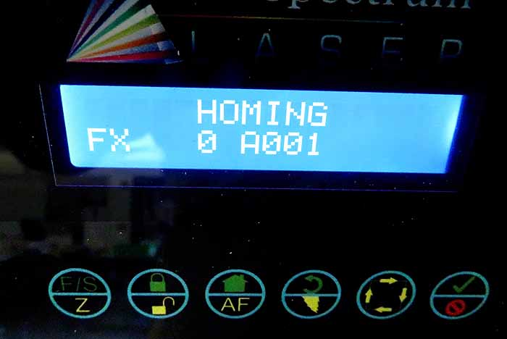
Homing
Set Mode Switch to “Fast X-Y”
Press “Home” switch( house)
Laser should home to top right corner of bed

Slide 10
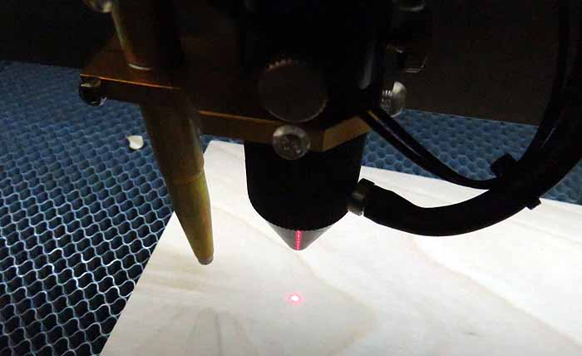
Adjust laser position
In “Fast X-Y” mode, use arrow keys to move laser to top left corner of etch area

Slide 11
Load Image into Adobe Illustrator
In Illustrator—Open- browse to SVG file on desktop or Google Drive-open file
Show Grid- resize if needed

Slide 12
Browsing to file in Illustrator

Slide 13
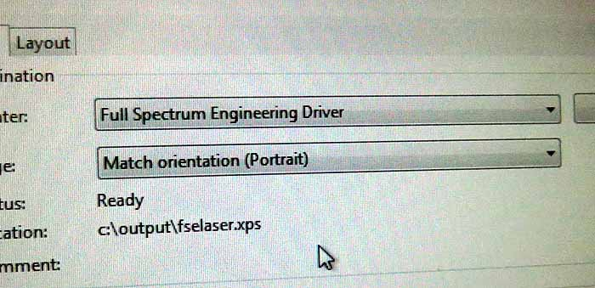
Print- Part 1
When image is correct size, do File-Print with Adobe Ilustrator—Select “Full Spectrum Engineering Driver”

Slide 14
If Image is > Letter Size- Print

Slide 15
Setup- Set to Portrait Mode- click Advanced Tab

Slide 16
Set Paper Size to FS Pro 20x12

Slide 17
In Retina Engrave- Zoom out with –Magnifying Glass

Slide 18
Open Retina Engrave
Image should open in Retina Engrave
For Vector Cut:
Select Vector Tab
Adjust Vector power—
15% for cutting thin material
60% for ¼” maple
12% for vector engrave of wood

Slide 19
Set Power

Slide 20
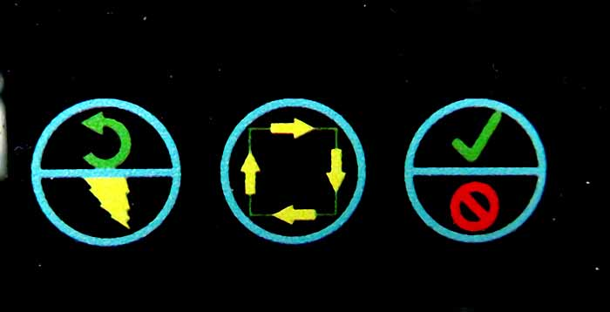
Check Perimeter
Push Perimeter button to see etch area
Adjust position with arrow keys

Slide 21
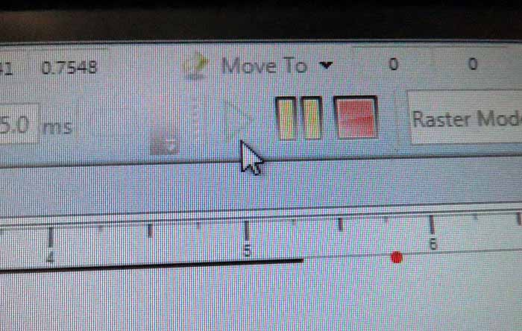
Run Job
Click on Green Arrow in Retina Engrave; job should start

Slide 22
Do Not run laser unattended!
When job finishes, open door and remove material
Shut off laser
Shut down wall power

