Slide 1
PREPARING VECTOR IMAGES IN ADOBE ILLUSTRATOR
WESTON MIDDLE SCHOOL

Slide 2
OPEN ADOBE ILLUSTRATOR
OPEN ADOBE ILLUSTRATOR FROM LAUNCHPAD
FILE-IMAGENAME-OPEN

Slide 3
ADJUST ARTBOARD-USE HANDLES

Slide 4
IMAGE TRACE
SELECT –ALL
OBJECT—IMAGE TRACE- MAKE AND EXPAND

Slide 5
IMAGE TRACE

Slide 6
COMPOUND PATH- MAKE

Slide 7
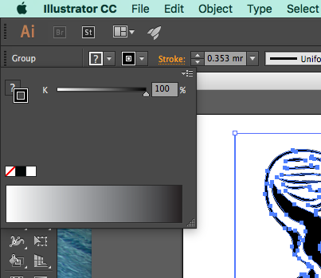
SET PATH COLOR
SET OUTLINE COLOR TO BLACK

Slide 8
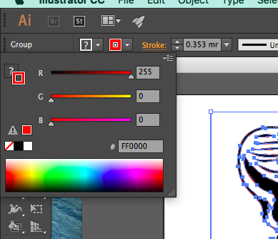
SET PATH COLOR
SET OUTLINE COLOR TO RED

Slide 9
SET FILL COLOR
SET FILL TO BLACK FOR RASTER SCAN
SET FILL TO NONE FOR VECTOR ENGRAVING
SET STROKE WIDTH TO HAIRLINE FOR VECTOR CUTTING
SAVE AS FILENAME.SVG

Slide 10
ADJUST SIZE
SHOW GRID, RULERS
SELECT ALL
OBJECT—TRANSFORM—SCALE
USE UNIFORM PERCENT

Slide 11
ADJUST SIZE WITH SCALE

Slide 12
SAVE
SAVE AS YOURFILENAME.SVG

